Slide 1
Engine 107 inventory Pierce 1500 GPM Pumper 500 Gallon Water Tank 50 Gallon Foam Tank

Slide 2
Engine 107 Spec / Captains Comp.
Engine 107 Spec
Captains Compartment (11):
Note Pad
IRPG
ERG (Emergency Response Guide)
Chem Bio Hand Book
Fire Scope Field Operation
City Of Arcadia Fire Watch Requirements
Employee Services Request Form
AA/AAA Bat
Garmen
Sheers
N/95 Mask
Gown
Hero Wipes
TIC
Mag Light
Radio Red Green
Radio Holder
Com Plan
Clip Board
Dist. Map

Slide 3
Center Comp (11)
Map Book
ERPG Area C
Wild Land Urban Interface
Spill Way Preplan
MCI Book
CNG Emergency Response
Fire Pre-Plans
Niosh Hazmat / Fire Scope
Earthquake Plan
RIC Pouch
First in Guide
Key Board
Binoculars

Slide 4
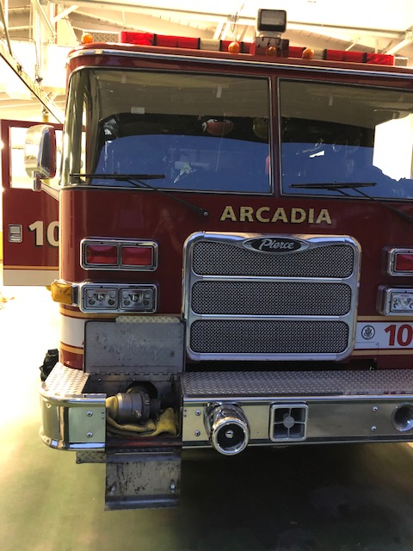
Front Bumper
9ft 4” supply line
Mallet
Hydrant wrench

Slide 5
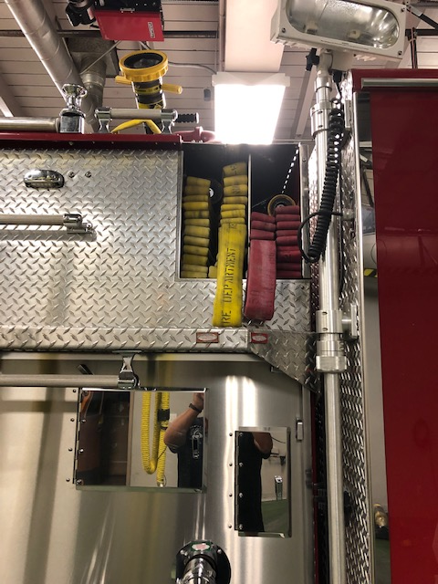
Transverse
Red : 200ft 1’’ ½ w/ TSM-20F
Blue : 300ft 1’’ ¾ w/ TSM-20F
Booster Reel : 200ft Bubble cup Nozzle

Slide 6
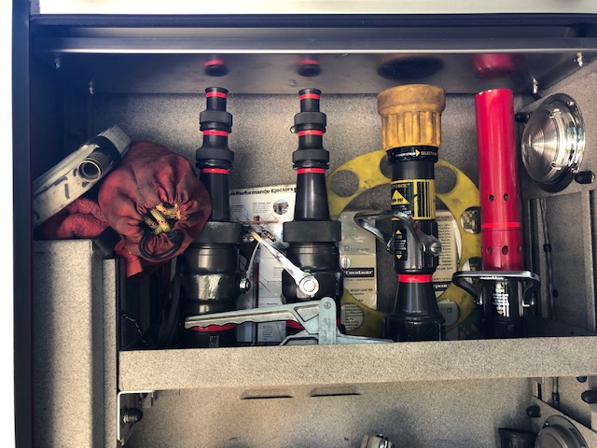
Engineer Shelf 1
100ft Garden Hose/
Rim Nut Protector
Throw Bag
Engineers sheets
Gaskets
DSM-30F w/ 75-325 GPM
(2) Smooth bore’s ( 1’’ , 1 1/8’’ , 1 ¼’’ 2 ½ ‘’ ) 200/250/325 GPM
Elkhart Air Aspirating Foam Nozzle
Gaiter Clamps

Slide 7
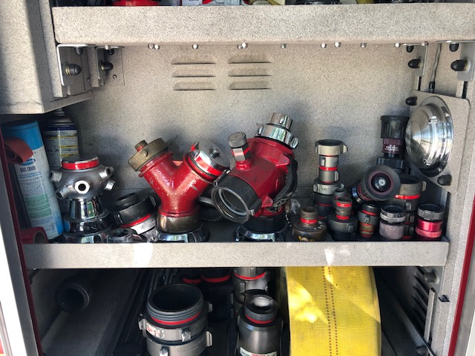
Engineer Shelf 2
Window Cleaner
WD40
Flagging
Brensen Cellar Nozzle
Wye
Siamese wye
2’’ Double Male/Females
1 ½ ‘’ Double Male/Female
1’’ Double Male/Females
1’’ ½ ‘’ to 2 ½ ‘’ Increaser
2 ½ to 1 ½/ 1 Decreases
2 ½ Cap
1 ½ Cap
1’’ NH to NP / 1’’ NP to NH
Wildland T’s
Wild Land Nozzles

Slide 8
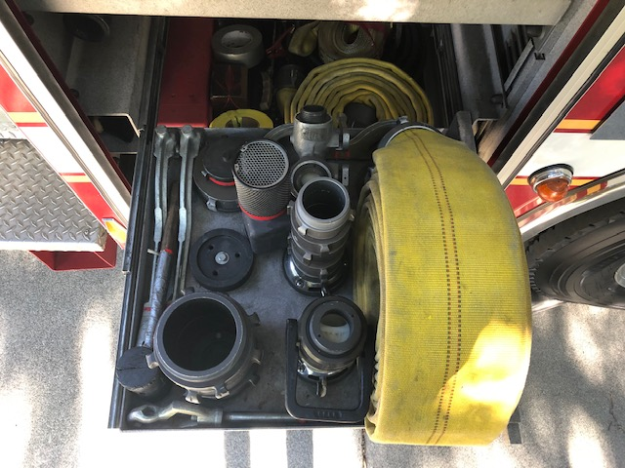
Engineer Shelf 3
4’’ Double Male/Females
Water Educator
Strainer
Spanner Wrenches
Rubber Mallet
Hydrant Wrench
2 ½ Shut Off Valve
Gated Wye 1 ½
33 feet of 4” Supply
Tiger Tooth

Slide 9
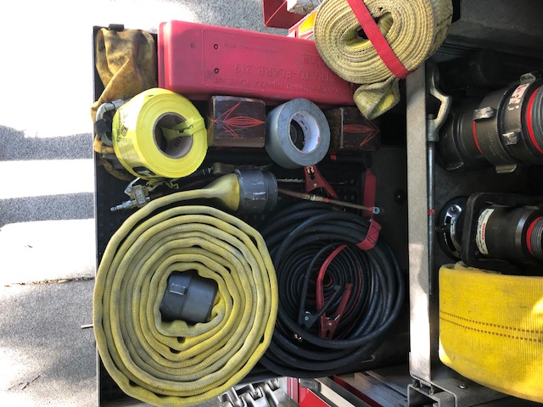
Engineer Shelf 4
Tow Strap
Road Triangle
Flair / w carabiner
Elec Tape
Duct Tape
Caution Tape
Hose Block
Jumper Cable
Air Line
_____ 2 ½
Tiger Key
Huskey Jack Handle

Slide 10
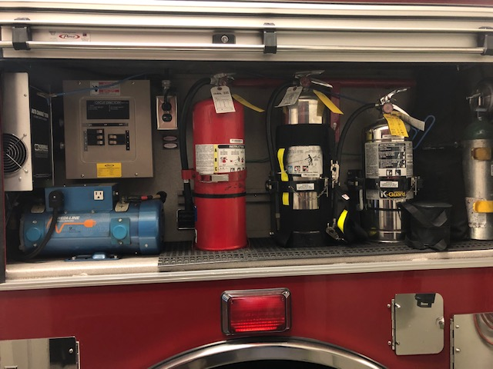
Eng. Side Comp:
Amerex Wet Chem 2-A:K
KIDDE Stored – Pressure 2A Water Can
FIGGIE 10BC Carbon Dioxide
Class K Ext. Water Can
02 Tank – D
Circuit Breaker
Power Outlet
Hydrant Key
Lock Out Kit
Auto Charge 1200
Redi-Line Generator

Slide 11
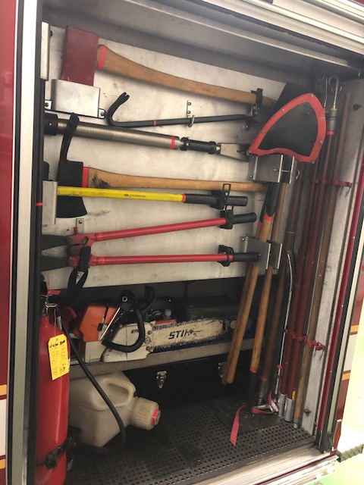
Eng. Back Comp:
Flat Headed Axe
Prybar
Ram Bar
Pulaski
8Ibs Sledge Hammer
36’’ Bolt Cutters
Digging Shovel
Scrape Shovel
Squeegee Pole w/ Squeegee
Hot Stick
McCloud
Hooligan
Halligan
Push Broom Stick w/ Broom
STIHL 460 Chainsaw
Reserve premix
Chain Saw Ammo Box
Kitty litter
Tool Box
36 lbs Co2 Tank
Cones
1200 Pound Husky Jack

Slide 12
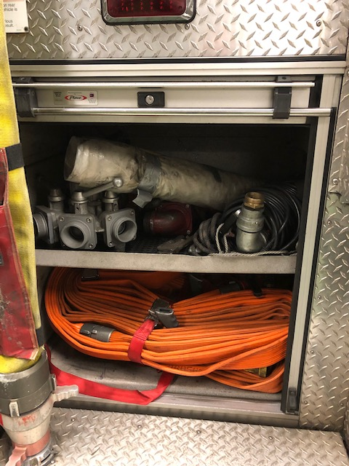
Rear Compartment
Rear Comp Top:
Sump Pump
Utility Rope
Tri-Wye
4-way Akron valve
Channel Locks
Rear Comp Bottom:
50ft 2 ½ bundle
A & B 100ft 1 ¾ Cleveland Packs w/ (2)TSM-20F & Gated Wye
Pig Tail
200 ft Weather all polyethylene hall runner

Slide 13
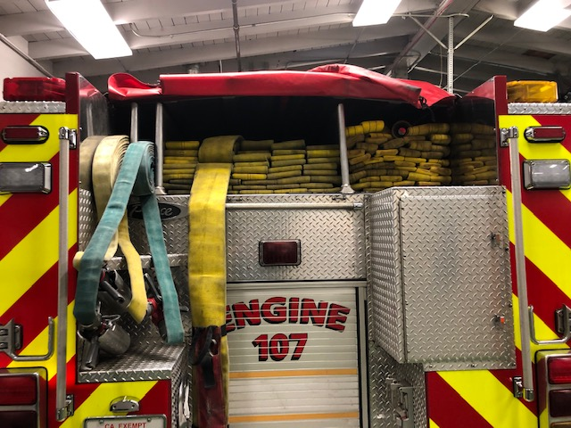
Back Loads
Back Loads :
(2) 200ft Miami Loads w/ TSM-20F
800ft 4’’ w/ bullet & hydrant wrench
800ft 2 ½’’ w/ TSM-30F

Slide 14
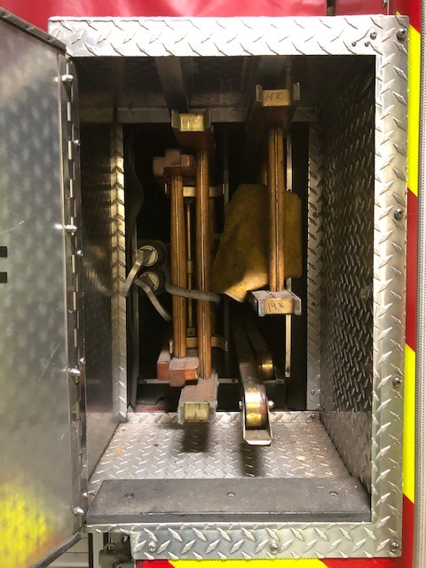
Engine Ladders & Other:
10ft Attic / 14ft Roof / 24ft Ext.
6 & 8 ft Pike Poles
Mechanical Axe

Slide 15
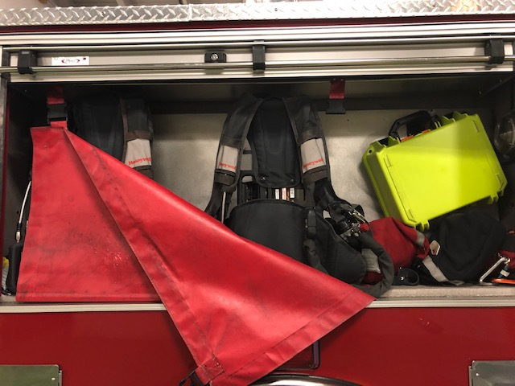
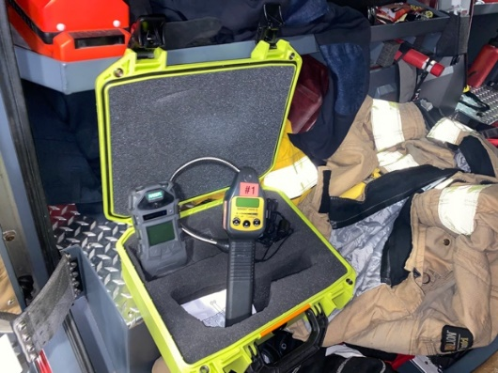
Capt Rear Comp:
(2) SCBA’s
Four Gas
Multi-Gas

Slide 16
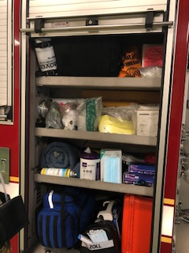
EMS COMP:
Triage Packs
OB Kit
Pet O2 Mask
Trash Bags
Iso Kits
N95s
BVM’s S/M/L
Sani Wipes
Gloves
Splints
MCI Triage Pack
Blanket
Hospital Cleaner
Zoll x Series
Airway Bag
Hazmat Bags
Zoll x Series
Airway Bag
Drug Box

Slide 17
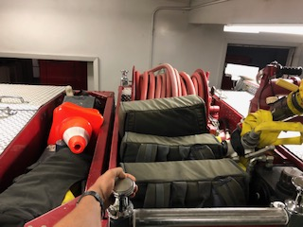
Top Deck:
Webbing
Starter Pack
Smokey Packs
Deck Gun
Smooth Bore Nozzle
Ground Monitor
Foam Hose
4 cots and sleeping bags

